Slide 1
Object Oriented Programming
Amey Karkare
karkare@iitk.ac.in

Slide 2
Reference
Object-Oriented Analysis and Design with Applications
By Grady Booch et. al.

Slide 3
Abstractions
Real world too complex to understand
Each of us have our own unique view of stuff around us
Ignore what is not important or not suitable
Focus on what is important
Abstractions in CSE
What vs How
Interfaces, Declarations, Types
Modelling of complex real-world objects

Slide 4
Imperative Programming
Data
Code
Functions
Example: A Stack
Abstraction: push, pop, top, is_empty
Implementation: One possibility
Data: Array, pointer/index, counter
Functions: to implement the operations
Code: Array manipulation
Loose Coupling

Slide 5
Object Oriented Paradigm
Think in terms of Objects
Properties of objects
“Snapshot” (values) at a given instance
How the values change over time, in response to the activities in the rest of the world

Slide 6
Object?
Tangible? Visible?
Real? Abstract?
Well defined role.
Crisp conceptual boundaries.

Slide 7


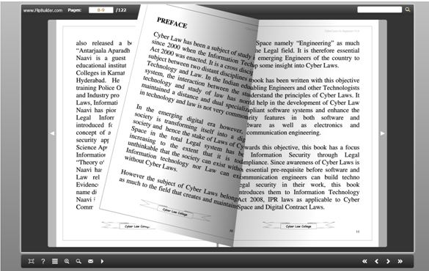

An Object in Programming
Has State
Exhibits well-defined Behavior
Has a Unique Identity
Amey’s Book

Slide 8
State
Property: An inherent or distinctive characteristic, trait, quality of feature
Properties have Value
State = The values of properties of an object at a given instant

Slide 9

Exercise
A “River” Object
State: Discuss different properties that a river could have
Sets of possible values for these properties?

Slide 10
Behavior
Any object exists in an environment consisting of other objects
Any object acts on itself and other objects
Behavior: How an object acts and reacts
Change in state

Slide 11
Exercise
A “River” Object
Behavior: Discuss different actions of river
changes to self due to self, to others due to self, to self due to others (Who are the other objects?)

Slide 12
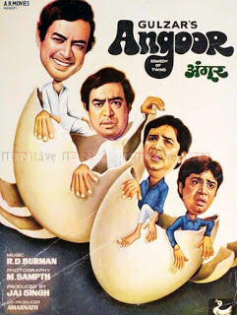

Identity
The property of an object which distinguishes it from all other objects

Slide 13
Exercise
A “River” Object
Identity: Identity of rivers in India
What are the distinguishing factors?

Slide 14
Relationships among Objects
Any realistic system consists of several collaborating objects
Two kind of important object relationships
Links
Aggregation

Slide 15
Links
A specific association through which one object (the client) applies the services of another object (the supplier)
Or through which one object may navigate to another

Slide 16
Participants in Links
As a participant in a link, an object may play one of three roles:
Controller: Operates on other objects
Server: Operated on by other objects
Proxy: Both – operates on other objects, operated on by other objects

Slide 17
Aggregation
A whole/part hierarchy
Ability to navigate from the whole (aggregate) to its parts

Slide 18
Link vs Aggregate trade-offs
Aggregate encapsulates parts as secrets of the whole
Links permit looser coupling among the objects
“in-house” vs “out-source”
Personal car vs. Ola/Uber

Slide 19
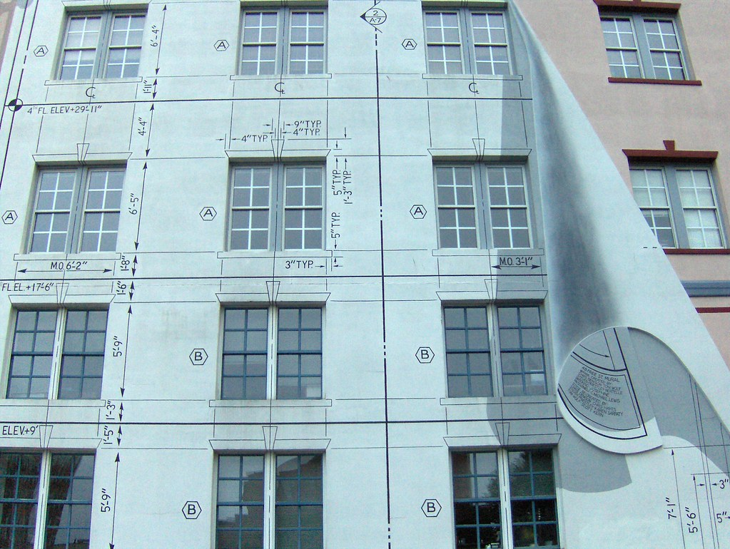
Class
An object is a concrete entity
Exists in time and space (of a program)
A class represents an abstraction
The “essence” of an object
Blueprint of a house
vs.
the house itself
This Photo by Unknown Author is licensed under CC BY-SA-NC

Slide 20
Class
Implementing abstractions
Class = data + functions
Functions operate on data
Data: Properties (State)
Functions: Actions (Behavior)

Slide 21
Interface and Implementation
A class captures the structure and behavior common to all related objects
The interface of a class provides its outside view
Abstraction
Hides the structure and other secrets
The implementation of a class is its inside view
Secrets of its behavior

Slide 22
Interface
Public
Protected
Private
Package
Implementation language dependent
What about friends?
Encapsulation

Slide 23
Relationships among Classes
“is” relationship
Popcorn is Food
“has” relationship
A Car has Wheels

Slide 24
Inheritance or “is” relationship
Generalization/specialization relationship
A Square is a Rectangle
A Rectangle is a Quadrilateral
Single Inheritance
Multiple Inheritance
Diamond Problem

Slide 25
Association or “has” relationship
One-to-one
Car has an Engine
One-to-many
Car has wheels
Many-to-many
Customer and Salesperson

Slide 26
Polymorphism
Ad hoc polymorphism
Overloading
Parametric polymorphism
Subtyping polymorphism
Overriding

Slide 27
Metrics for Quality of Abstraction
Coupling
Cohesion
Sufficiency
Completeness
Primitiveness

Slide 28
Practical Example: Bank Persons
Person
BankPerson
Customer
Employee
Normal
Customer
Premium
Customer
28

Slide 29
Person
-name -lastname -birthdate
+getName() +getAge() +setBirthDate()
Person
BankPerson
Customer
Employee
Normal
Customer
Premium
Customer

Slide 30
Person
-name -lastname -birthdate
+getName() +getAge() +setBirthDate()
Person
BankPerson
BankPerson
-nextID -ID
+isCustomer() +getID()
Customer
Employee
Normal
Customer
Premium
Customer

Slide 31
Person
Person
BankPerson
-nextID -ID
+isCustomer() +getID()
BankPerson
Customer
Employee
Employee
-manager
+isCustomer() +getManager()
Normal
Customer
Premium
Customer

Slide 32
BankPerson
-nextID -ID
+isCustomer() +getID()
Person
BankPerson
Customer
-savings -FDs
+getSavings() +getFDs() +addSavings() … +isCustomer()
Customer
Employee
Normal
Customer
Premium
Customer

Slide 33
Inheritance
A Customer is a BankPerson
An Employee is a BankPerson
A PremiumCustomer is a Customer
is a BankPerson, is a Person
Various nomenclatures
Super class, Sub class
Base class, Derived Class
…

Slide 34
Overriding Functionality
Derived class can override functionality in its base class (or some class up in the hierarchy)
Base class can leave the functionality undefined (Virtual or Abstract function)
Such a class (having abstract function) is called Abstract class
Cannot be instantiated directly

Slide 35
Subtype Polymorphism
Inheritance naturally suggests subtype polymorphism
Since a PremiumCustomer is a Customer, any functionality applicable to Customer must also be applicable to PremiumCustomer
If Customers are subject to tax deductions, so are Premium Customers
Rates could be different though
Reverse is not necessarily true
Premium Customers may get a relationship manager, but not all Customers

Slide 36
Reference/Pointer Assignments
PremiumCustomer *p1, *p2;
Customer *c1, *c2;
p1 = new PremiumCustomer(); // OK
c1 = new Customer(); // OK
// One of the following is NOT OK
p2 = c1;
c2 = p1;
// not OK
// OK

Slide 37
Polymorphism
… processCustomer(Customer *c)
… processCustomer(PremiumCustomer *p)
… processCustomer(NormalCustomer *n)
vs.
c->process() // c is Customer*

Slide 38
Events in the Life of an Object
Construction
Usage
Destruction
Java does not have a concept of destructor
It uses a related concept called Finalization (similar purpose, but not quite the same as destruction)

Slide 39
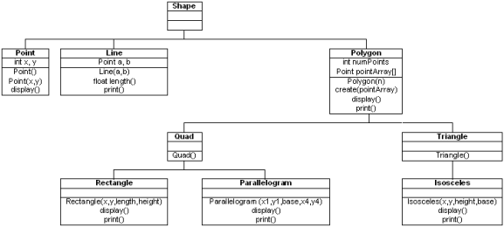
Discussion
Improve Geometry Package using OOP

Slide 40
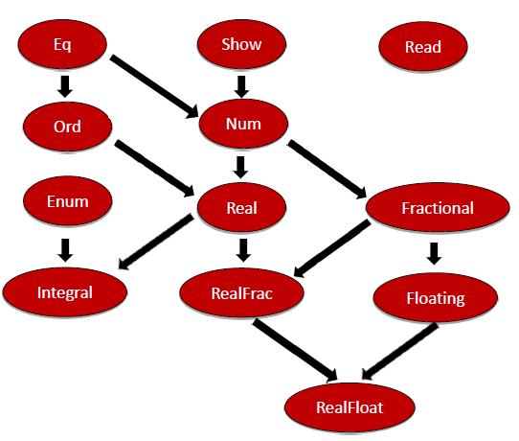
Haskell Type-class Hierarchy

Slide 41
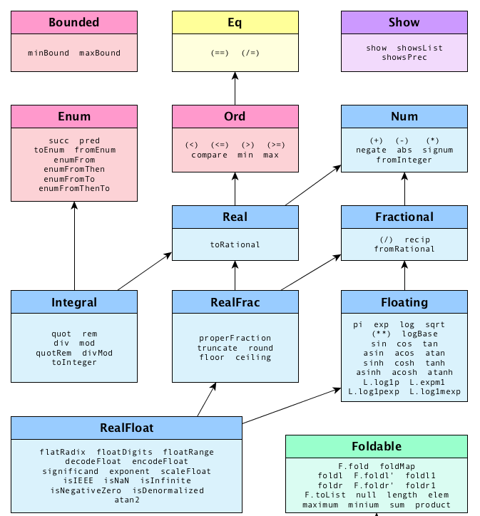
Haskell Type-class Hierarchy

Slide 42

Once you know OOP
Mere pass struct hai, union hai, class hai, member functions hain. Tumhare pass kya hai? Hain…
Mere pass
Object Oriented Paradigm hai!

Slide 43

Design Patterns
Coming up next…

